Slide 1
Functional Dependencies and Normalization for Relational Databases

Slide 2
Informal Design Guidelines for Relational Databases
Relational database design: The grouping of attributes to form "good" relation schemas
Two levels of relation schemas:
The logical "user view" level
The storage "base relation" level
Design is concerned mainly with base relations
Criteria for "good" base relations:
Discuss informal guidelines for good relational design
Discuss formal concepts of functional dependencies and normal forms 1NF 2NF 3NF BCNF

Slide 3
Semantics of the Relation Attributes
Each tuple in a relation should represent one entity or relationship instance
Only foreign keys should be used to refer to other entities
Entity and relationship attributes should be kept apart as much as possible
Design a schema that can be explained easily relation by relation. The semantics of attributes should be easy to interpret.

Slide 4
Definition
This is the process which allows you to winnow out redundant data within your database.
This involves restructuring the tables to successively meeting higher forms of Normalization.
A properly normalized database should have the following characteristics
Scalar values in each fields
Absence of redundancy.
Minimal use of null values.
Minimal loss of information.
Notes:
4

Slide 5
Levels of Normalization
Levels of normalization based on the amount of redundancy in the database.
Various levels of normalization are:
First Normal Form (1NF)
Second Normal Form (2NF)
Third Normal Form (3NF)
Boyce-Codd Normal Form (BCNF)
Fourth Normal Form (4NF)
Fifth Normal Form (5NF)
Domain Key Normal Form (DKNF)
Redundancy
Number of Tables
Complexity
Most databases should be 3NF or BCNF in order to avoid the database anomalies.
Notes:
5

Slide 6
Levels of Normalization
1NF
2NF
3NF
4NF
5NF
DKNF
Each higher level is a subset of the lower level
Notes:
6

Slide 7
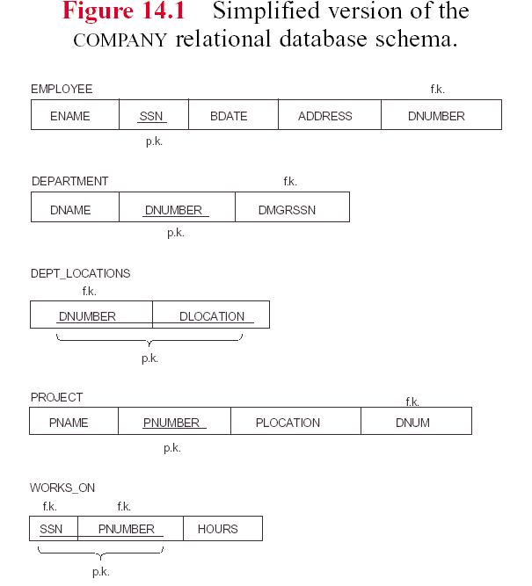

Slide 8
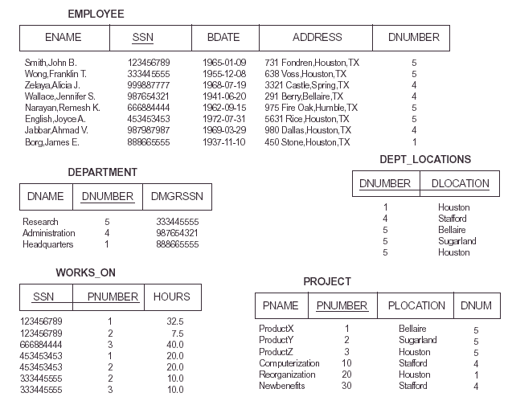

Slide 9
Redundant Information in Tuples and Update Anomalies
Mixing attributes of multiple entities may cause problems
Information is stored redundantly wasting storage
Problems with update anomalies:
Insertion anomalies
Deletion anomalies
Modification anomalies

Slide 10
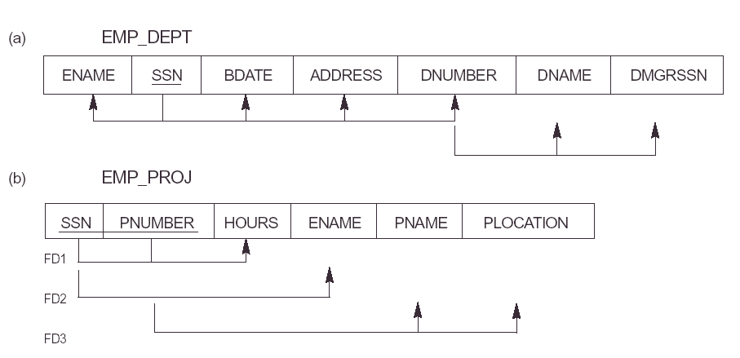

Slide 11
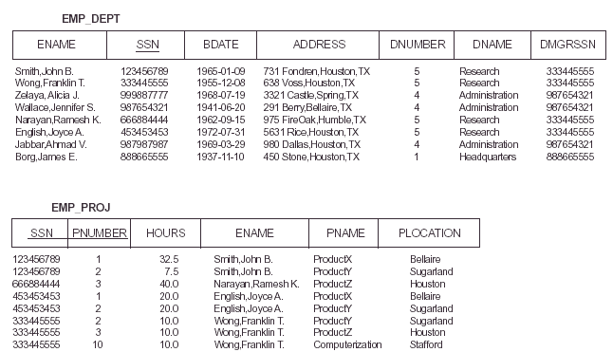

Slide 12
EXAMPLE OF AN UPDATE ANOMALY
Consider the relation:
EMP_PROJ ( Emp#, Proj#, Ename, Pname, No_hours)
Update Anomaly
Changing the name of project number P1 from “Billing” to “Customer-Accounting” may cause this update to be made for all 100 employees working on project P1
Insert Anomaly
Cannot insert a project unless an employee is assigned to .
Inversely- Cannot insert an employee unless he/she is assigned to a project.

Slide 13
EXAMPLE OF AN UPDATE ANOMALY (2)
Delete Anomaly
When a project is deleted, it will result in deleting all the employees who work on that project. Alternately, if an employee is the sole employee on a project, deleting that employee would result in deleting the corresponding project.
Design a schema that does not suffer from the insertion, deletion and update anomalies. If there are any present, then note them so that applications can be made to take them into account

Slide 14
Null Values in Tuples
Relations should be designed such that their tuples will have as few NULL values as possible
Attributes that are NULL frequently could be placed in separate relations (with the primary key)
Reasons for nulls:
a. attribute not applicable or invalid
b. attribute value unkown (may exist)
c. value known to exist, but unavailable

Slide 15
Spurious Tuples
Bad designs for a relational database may result in erroneous results for certain JOIN operations
The "lossless join" property is used to guarantee meaningful results for join operations
The relations should be designed to satisfy the lossless join condition. No spurious tuples should be generated by doing a natural-join of any relations

Slide 16
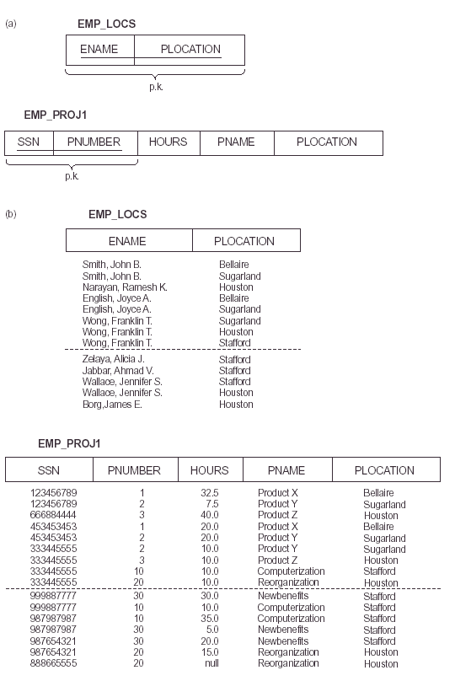

Slide 17
Functional Dependencies
Functional dependencies (FDs) are used to specify formal measures of the "goodness" of relational designs
FDs and keys are used to define normal forms for relations
FDs are constraints that are derived from the meaning and interrelationships of the data attributes

Slide 18
Functional Dependencies (2)
A set of attributes X functionally determines a set of attributes Y if the value of X determines a unique value for Y
X →Y holds if whenever two tuples have the same value for X, they must have the same value for Y
If t1[X]=t2[X], then t1[Y]=t2[Y] in any relation instance r(R)
X → Y in R specifies a constraint on all relation instances r(R)
FDs are derived from the real-world constraints on the attributes

Slide 19
Examples of FD constraints
Social Security Number determines employee name
SSN → ENAME
Project Number determines project name and location
PNUMBER → {PNAME, PLOCATION}
Employee SSN and project number determines the hours per week that the employee works on the project
{SSN, PNUMBER} → HOURS

Slide 20
Functional Dependencies (3)
An FD is a property of the attributes in the schema R
The constraint must hold on every relation instance r(R)
If K is a key of R, then K functionally determines all attributes in R (since we never have two distinct tuples with t1[K]=t2[K])

Slide 21
Inference Rules for FDs
Given a set of FDs F, we can infer additional FDs that hold whenever the FDs in F hold
Armstrong's inference rules
A1. (Reflexive) If Y subset-of X, then X → Y
A2. (Augmentation) If X → Y, then XZ → YZ
(Notation: XZ stands for X U Z)
A3. (Transitive) If X → Y and Y → Z, then X → Z
A1, A2, A3 form a sound and complete set of inference rules

Slide 22
Additional Useful Inference Rules
Decomposition
If X → YZ, then X → Y and X → Z
Union
If X → Y and X → Z, then X → YZ
Psuedotransitivity
If X → Y and WY → Z, then WX → Z
Closure of a set F of FDs is the set F+ of all FDs that can be inferred from F

Slide 23
Functional Dependencies (Cont.)
Let R be a relation schema
α ⊆ R and β ⊆ R
The functional dependency
α → β holds on R if and only if for any legal relations r(R), whenever any two tuples t₁ and t₂ of r agree on the attributes α, they also agree on the attributes β. That is,
t₁[α] = t₂ [α] ⇒ t₁[β ] = t₂ [β ]
Example: Consider r(A,B ) with the following instance of r.
On this instance, A → B does NOT hold, but B → A does hold.
4
1 5
3 7

Slide 24
Functional Dependencies (Cont.)
K is a superkey for relation schema R if and only if K → R
K is a candidate key for R if and only if
K → R, and
for no α ⊂ K, α → R
Functional dependencies allow us to express constraints that cannot be expressed using superkeys. Consider the schema:
bor_loan = (customer_id, loan_number, amount ).
We expect this functional dependency to hold:
loan_number → amount
but would not expect the following to hold:
amount → customer_name

Slide 25
Use of Functional Dependencies
We use functional dependencies to:
test relations to see if they are legal under a given set of functional dependencies.
If a relation r is legal under a set F of functional dependencies, we say that r satisfies F.
specify constraints on the set of legal relations
We say that F holds on R if all legal relations on R satisfy the set of functional dependencies F.
Note: A specific instance of a relation schema may satisfy a functional dependency even if the functional dependency does not hold on all legal instances.
For example, a specific instance of loan may, by chance, satisfy amount → customer_name.

Slide 26
Functional Dependencies (Cont.)
A functional dependency is trivial if it is satisfied by all instances of a relation
Example:
customer_name, loan_number → customer_name
customer_name → customer_name
In general, α → β is trivial if β ⊆ α

Slide 27
Closure of a Set of Functional Dependencies
Given a set F of functional dependencies, there are certain other functional dependencies that are logically implied by F.
For example: If A → B and B → C, then we can infer that A → C
The set of all functional dependencies logically implied by F is the closure of F.
We denote the closure of F by F⁺.
F⁺ is a superset of F.

Slide 28
Closure of a Set of Functional Dependencies
Given a set F set of functional dependencies, there are certain other functional dependencies that are logically implied by F.
For example: If A → B and B → C, then we can infer that A → C
The set of all functional dependencies logically implied by F is the closure of F.
We denote the closure of F by F⁺.
We can find all of F⁺ by applying Armstrong’s Axioms:
if β ⊆ α, then α → β (reflexivity)
if α → β, then γ α → γ β (augmentation)
if α → β, and β → γ, then α → γ (transitivity)
These rules are
sound (generate only functional dependencies that actually hold) and
complete (generate all functional dependencies that hold).

Slide 29
Example
R = (A, B, C, G, H, I) F = { A → B A → C CG → H CG → I B → H}
some members of F⁺
A → H
by transitivity from A → B and B → H
AG → I
by augmenting A → C with G, to get AG → CG and then transitivity with CG → I
CG → HI
by augmenting CG → I to infer CG → CGI,
and augmenting of CG → H to infer CGI → HI,
and then transitivity

Slide 30
Procedure for Computing F⁺
To compute the closure of a set of functional dependencies F:
F ⁺ = F repeat for each functional dependency f in F⁺ apply reflexivity and augmentation rules on f add the resulting functional dependencies to F ⁺ for each pair of functional dependencies f₁and f₂ in F ⁺ if f₁ and f₂ can be combined using transitivity then add the resulting functional dependency to F ⁺ until F ⁺ does not change any further
NOTE: We shall see an alternative procedure for this task later

Slide 31
Closure of Functional Dependencies (Cont.)
We can further simplify manual computation of F⁺ by using the following additional rules.
If α → β holds and α → γ holds, then α → β γ holds (union)
If α → β γ holds, then α → β holds and α → γ holds (decomposition)
If α → β holds and γ β → δ holds, then α γ → δ holds (pseudotransitivity)
The above rules can be inferred from Armstrong’s axioms.

Slide 32
Closure of Attribute Sets
Given a set of attributes α, define the closure of α under F (denoted by α⁺) as the set of attributes that are functionally determined by α under F
Algorithm to compute α⁺, the closure of α under F
result := α; while (changes to result) do for each β → γ in F do begin if β ⊆ result then result := result ∪ γ end

Slide 33
Example of Attribute Set Closure
R = (A, B, C, G, H, I)
F = {A → B A → C CG → H CG → I B → H}
(AG)⁺
1. result = AG
2. result = ABCG (A → C and A → B)
3. result = ABCGH (CG → H and CG ⊆ AGBC)
4. result = ABCGHI (CG → I and CG ⊆ AGBCH)
Is AG a candidate key?
Is AG a super key?
Does AG → R? == Is (AG)⁺ ⊇ R
Is any subset of AG a superkey?
Does A → R? == Is (A)⁺ ⊇ R
Does G → R? == Is (G)⁺ ⊇ R

Slide 34
Uses of Attribute Closure
There are several uses of the attribute closure algorithm:
Testing for superkey:
To test if α is a superkey, we compute α^{+,} and check if α⁺ contains all attributes of R.
Testing functional dependencies
To check if a functional dependency α → β holds (or, in other words, is in F⁺), just check if β ⊆ α⁺.
That is, we compute α⁺ by using attribute closure, and then check if it contains β.
Is a simple and cheap test, and very useful
Computing closure of F
For each γ ⊆ R, we find the closure γ⁺, and for each S ⊆ γ⁺, we output a functional dependency γ → S.

